Slide 1
ORGANISATIONAL
BEHAVIOUR
CHAPTER-7
LEARNING

Slide 2
LEARNING OBJECTIVES
1. Learning is modification of behaviour through practices, training or experience. It is an important input in individual behaviour.
2. Four theories explain how learning takes place. The four models are - classical conditioning, operant conditioning, cognitive learning, and social learning.
3. Learning principles need to be observed in any training programme. The principles are - motivation, reinforcement, learning curves, meaningfulness of material and learning styles.
4. Learning is an important component of OB because of its impact on individual behaviour
5. Just as there is learning by an individual, there is organizational learning too.

Slide 3
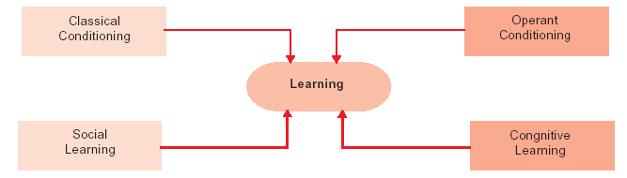
Theories of Learning

Slide 4
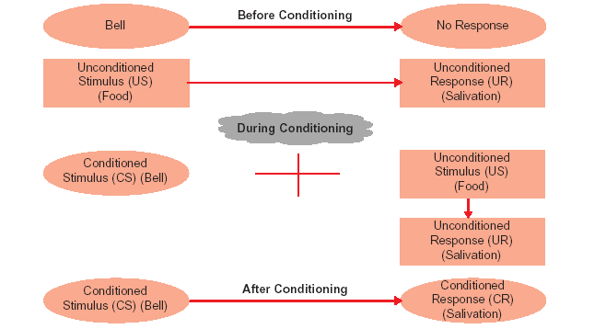
Classical Conditioning

Slide 5
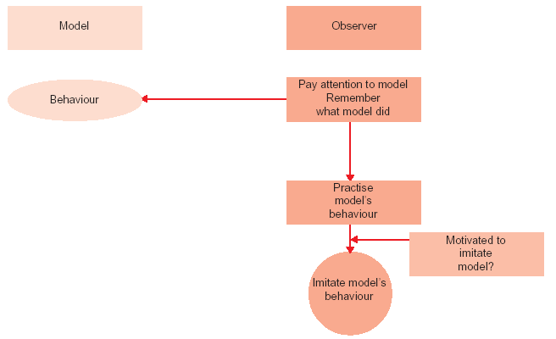
Observational Learning: An overview

Slide 6
Learning Principles
Motivation
Reinforcement, punishment and extinction
Whole versus part learning
Learning curves
Meaningfulness of material
Learning styles

Slide 7
Comparison of Schedules of Reinforcement
Schedules Description Example Influence on performance Effect on
behaviour
Fixed interval Reinforcers Pay cheque at the Average and irregular Fast extinction of
administered after end of each performance behaviour
a constant amount month
of time has
elapsed
Variable Reinforcers Boss passes by Leads to moderately Slow extinction
interval administered after employees desks high and stable of behaviour
a variable amount at different times performance
of time has elapsed on different days
Fixed ratio Reinforcers Piece rating of Leads quickly to very Moderately fast
schedule administered after wages or bonus high and stable extinction of
a constant number for every given performance behaviour
of actions performed amount of sales.
Variable ratio Reinforcers A slot machine Leads to very high Very slow
schedule administered after pays a jackpot, performance extinction
a variable number on average, one of behaviour
of actions performed time per million
plays

Slide 8
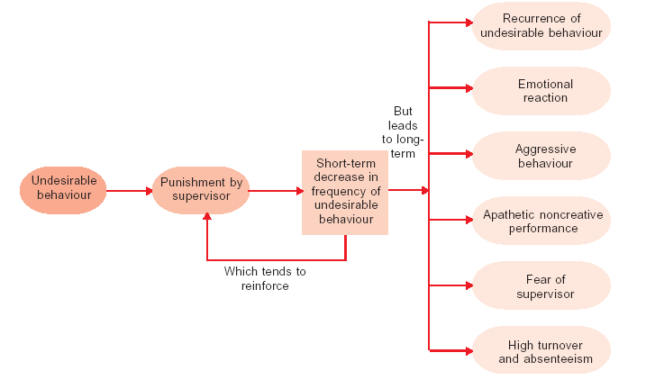
Negative Effects of Punishment

Slide 9
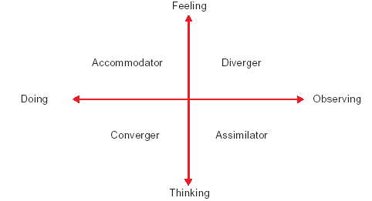
Learning Styles

Slide 10
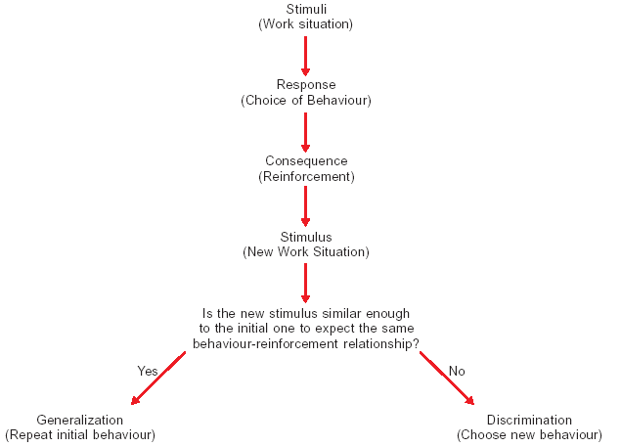
Stimulus Generalisation and Discrimination

Slide 11
Summary
        Learning is understood as the modification of behaviour through practice, training, or experience.
        Distinction is made between explicit knowledge and tacit knowledge. Explicit knowledge is organized and can be communicated from one person to another. Tacit knowledge is what one knows but cannot tell. “ I know but cannot express” typifies tacit knowledge. It is the duty of OB expert to convert tacit knowledge in to explicit knowledge.
        Learning occurs through classical conditioning, operate conditioning, cognitive process and observational process. Classical conditioning is based on the premise that a physical object that initially does not elicit a particular response gradually acquires the capacity to elicit that response as a result of repeated pairing with a stimulus that can elicit a reaction.
        Operant conditioning refers to the process that our behaviour produces certain consequences and how we behave in the future will depend on what those consequences are.
        Cognitive approach to learning assigns active role to the learning process. It assumes that people are conscious, active participants in how they learn. Organism learns depending on what meaning is assigned to the stimuli.
        Social learning, also called observational learning, occurs by observing others – parents, teachers, peers, film stars and other popular figures in public life. The learner picks up whatever the role model does or does not do.
        Learning becomes effective when it is based on certain principles. Important principles of learning are: motivation, reinforcement, whole versus part learning, learning curves and meaningfullness of material.

Slide 12
        Motivation to learn makes learning more effective. Without motivation, learning does not occur.
        Reinforcement refers to the consequences of a behaviour. If consequences of a behaviour are positive, there is a tendency to repeat the behaviour-there is a positive reinforcement. Behaviour does not get repeated when the consequences are negative-there is negative reinforcement. An individual gets motivated to learn more provided his or her earlier learning was adequately rewarded.
        Positive or negative reinforcement is administered through certain schedules. Schedules of reinforcement are fixed interval, variable interval, fixed ratio, and variable ratio. The latter too are more effective than the earlier two.
        Another principle of learning is-whole versus part learning. This refers to the decision whether learning the whole job is better or breaking the job into parts and learning the parts is more effective. No definite conclusion has been arrived on their issue.
        The trainer, (for whom the principles of learning are highly useful) should understand that learning proceeds in stages-called curves. There is great enthusiasm to learn at the commencement of a training session (initial spurt), then peaks (plateauing), there is fatigue and spurt at the end of the session.
        Learning becomes effective when the material learnt is meaningful.
        Learning is of great relevance to the study of OB. It stimulates generalization in organizations, stimulates discrimination in organizations, is the major objective in training and solves employee indiscipline.
        Organizational learning will be covered , in detail, in chapter 18.

Slide 13
Key Terms
Learning
Operant conditioning
Classical conditioning
Cognitive theory of learning
Social learning
Implicit knowledge
Explicit knowledge
Learning curves
Self-efficacy
Reinforcement schedules
Reinforcement
Positive reinforcers
Negative reinforcers
Learning styles
Organizational learning
Punishment
Stimulus generalization
Congitive theory of learning
Extinction.
Questions

